Slide 1

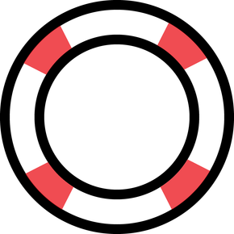
free Naloxone
q
Sept. 24, 2026
we Save
Lives
Washington County, Maryland
Hagerstown Community College
Washington County Free Library
Washington County Free Library
Washington County Free Library
Meritus Medical Center
Meritus Medical Center
Washington County Health Department
Washington County Health Department
Behavioral Health Group
Zion Baptist Church
Black Rock Integrative Medicine
Melody’s Corner Market
YMCA
Soul Haven WRC
Welty Church of the Brethren
11400 Robinwood Drive, Hagerstown MD 11-1 pm
104 E. Potomac St, Williamsport, MD 21795 11-12:30 pm
66 W. Water St, Smithsburg MD 21783 2-4 pm
106 E. Sharpsburg Pike, Sharpsburg, MD 21782 5-6:30 pm
11116 Medical Campus Road, Hagerstown, MD 21742 10-12 pm
13620 Crayton Blvd, Medical Plaza Hagerstown MD 21742 1-3 pm
925 N. Burhans Blvd, Hagerstown, MD 21742 8-4 pm
1302 Pennsylvania Ave, Hagerstown, MD 21740 8-4 pm
217 E Antietam St, Hagerstown, MD 21740 8-9 am
61 Bethel St. Hagerstown, MD 21740 4-5 pm
120 N. Potomac St. Hagerstown, MD 21740 12-1:30 pm
101 E. North St Hagerstown, MD 21740
1100 Eastern Blvd, Hagerstown, MD 21742 8:30-9:15 am & 4:30-5:15 pm
119 East Antietam St, Hagerstown, MD 21740 10-4 pm
13465 Greensburg Rd, Smithsburg, MD 21783 6 - 7 pm
240-313-3310 washcohealth.org call 711 for MD Relay (TTY)

Slide 2
free Naloxone
q
Sept. 24, 2026
we Save
Lives
Washington County, Maryland
240-313-3310 washcohealth.org call 711 for MD Relay (TTY)

